Slide 1
Object-Oriented Systems Development:
Using the Unified Modeling Language
Chapter 3:
Object-Oriented Systems Development Life Cycle

Slide 2

Goals
The software development process
Building high-quality software
Object-oriented systems development

Slide 3
Goals (Con’t)
Use-case driven systems development
Prototyping
Rapid application development
Component-based development
Continuous testing and reusability

Slide 4
Software Process
The essence of the software process is the transformation of
Users’ needs to
The application domain into
A software solution.

Slide 5
Software Process (Con’t)
Problem
Transformation 1
Statements
What are the uses
of the system.?
Analysis
Need
Needs
Transformation 2
Design
System
Implementation
Transformation 3
Software
Detail
Product

Slide 6

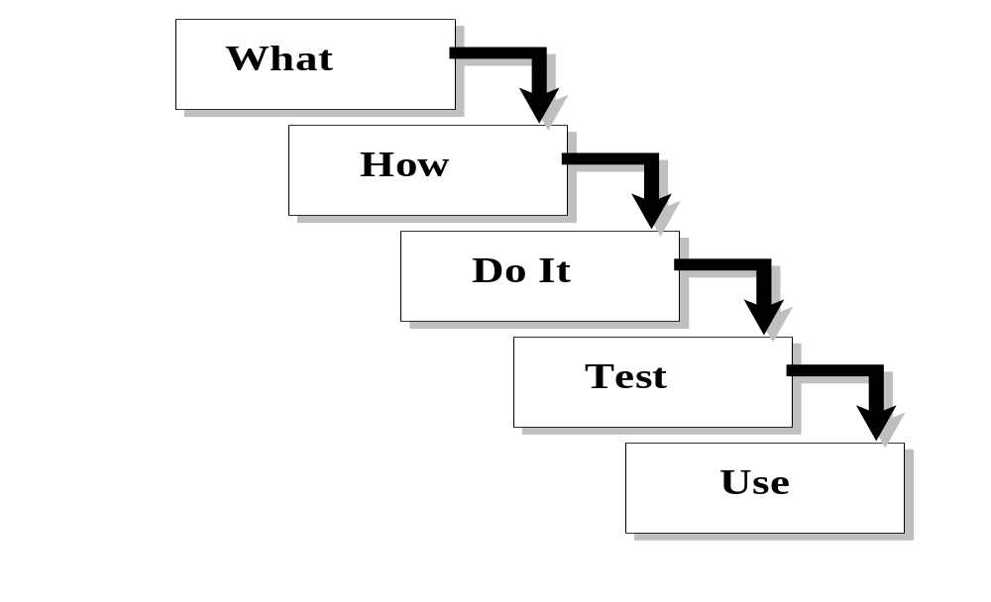
Traditional Waterfall Approach to Systems Development

Slide 7

Software Quality
There are two basic approaches to systems testing.
We can test a system according to how it has been built.
Alternatively, we can test the system with respect to what it should do.

Slide 8

Quality Measures
Systems can be evaluated in terms of four quality measures:
  Correspondence
  Correctness
  Verification
  Validation

Slide 9
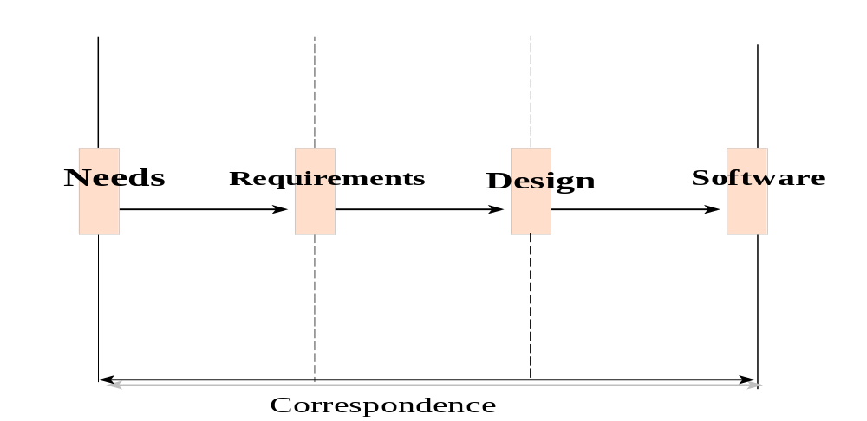
Quality Measures (Con’t)
Correspondence measures how well the delivered system corresponds to the needs of the operational environment.

Slide 10

How would you determine Correspondence?
It cannot be determined until the system is in place.

Slide 11
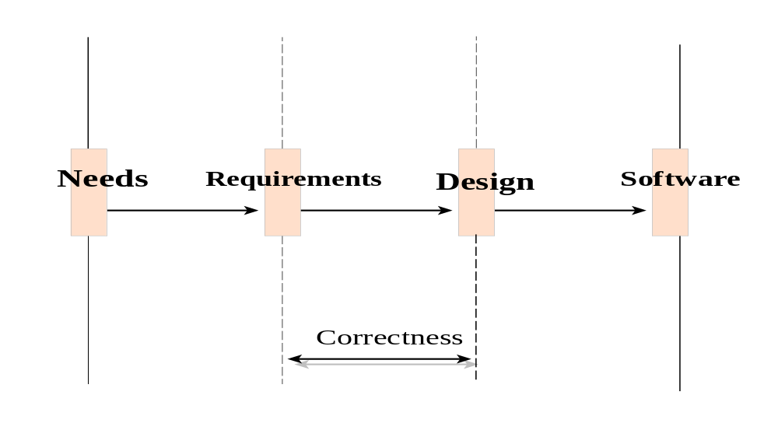
Quality Measures (Con’t)
Correctness measures the consistency of the product requirements with respect to the design specification.

Slide 12
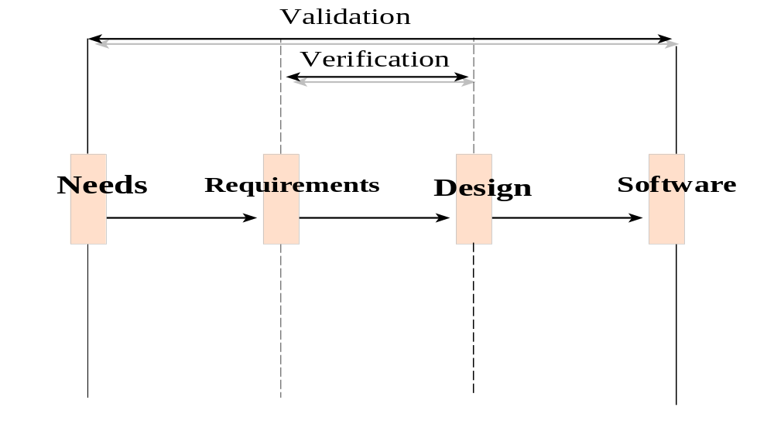
Quality Measures (Con’t)
Verification - "Am I building the product right?"
Validation - "Am I building the right product?"

Slide 13

Quality Measures (Con’t)
Verification is to predict the correctness.
Validation is to predict the correspondence.

Slide 14
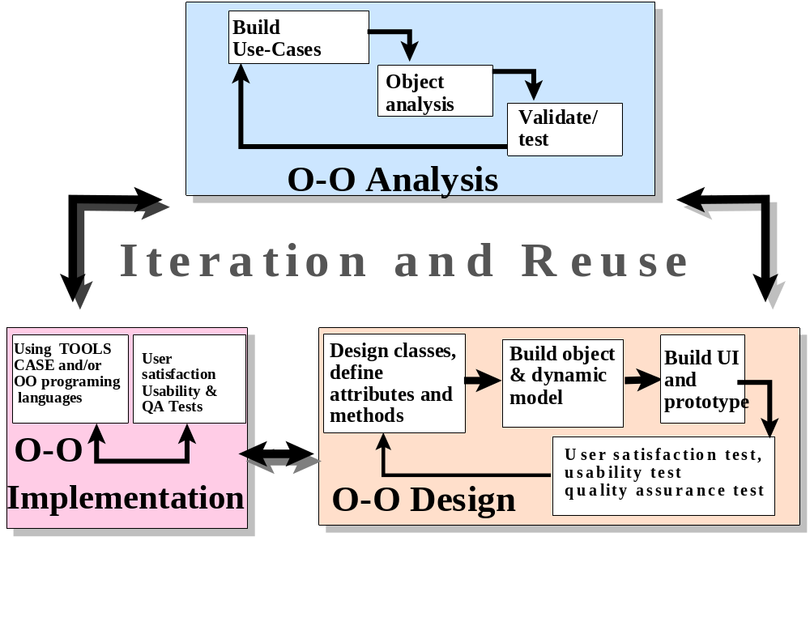
Object-Oriented Systems Development Approach

Slide 15
Object-Oriented Systems Development activities
Object-oriented analysis.
Object-oriented design.
Prototyping.
Component-based development.
Incremental testing.

Slide 16
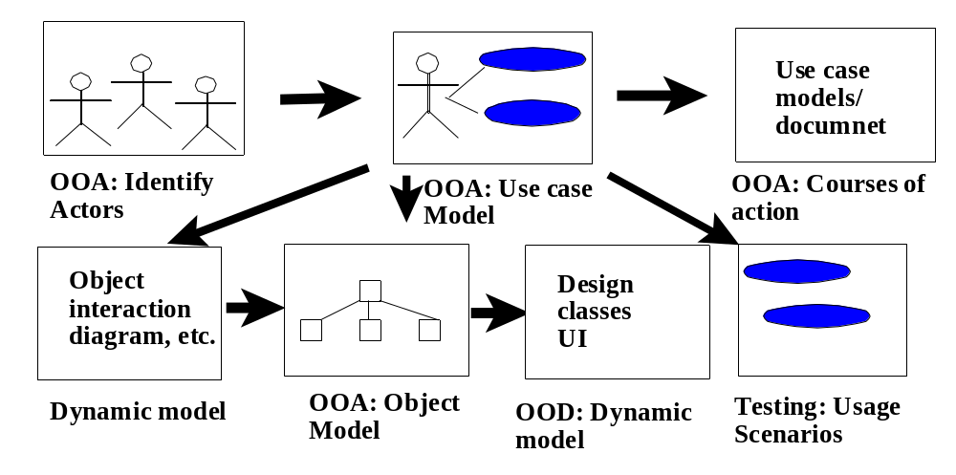
Use-case driven systems development
Use Case, is a name for a scenario to describe the user–computer system interaction.

Slide 17
Object-Oriented Analysis
OO analysis concerns with determining the system requirements and identifying classes and their relationships that make up an application.

Slide 18
Object-Oriented Design
The goal of object-oriented design (OOD) is to design:
The classes identified during the analysis phase,
The user interface and
Data access.

Slide 19
Object-Oriented Design (Con’t)
OOD activities include:
  Design and refine classes.
    Design and refine attributes.
    Design and refine methods.
    Design and refine structures.
    Design and refine associations.
  Design User Interface or View layer classes.
  Design data Access Layer classes.

Slide 20
Prototyping
A Prototype enables you to fully understand how easy or difficult it will be to implement some of the features of the system.
It can also give users a chance to comment on the usability and usefulness of the design.

Slide 21
Types of Prototypes
A horizontal prototype is a simulation of the interface.
A vertical prototype is a subset of the system features with complete functionality.

Slide 22
Types of Prototypes (Con’t)
An analysis prototype is an aid for exploring the problem domain.
A domain prototype is an aid for the incremental development of the ultimate software solution.

Slide 23
Component-based development (CBD)
CBD is an industrialized approach to the software development process.
Application development moves from custom development to assembly of pre-built, pre-tested, reusable software components that operate with each other.

Slide 24
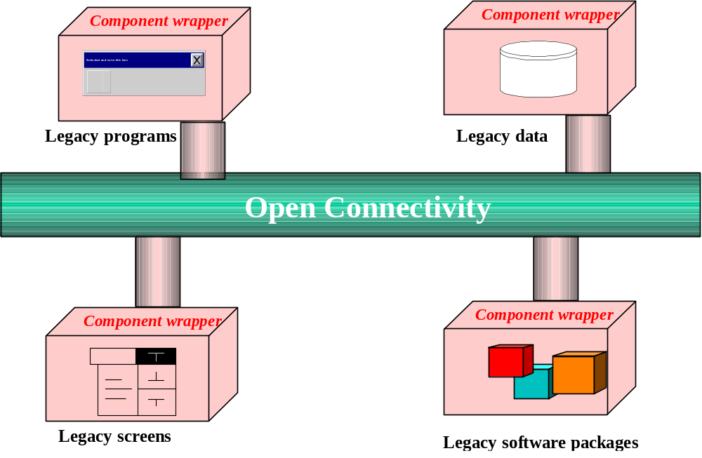
Component-based development (CBD) Con’t)

Slide 25
Rapid Application Development (RAD)
RAD is a set of tools and techniques that can be used to build an application faster than typically possible with traditional methods.

Slide 26
Rapid Application Development (RAD) (Con’t)
RAD does not replace SDLC but complements it, since it focuses more on process description and can be combined perfectly with the object-oriented approach.

Slide 27

Incremental Testing
Software development and all of its activities including testing are an iterative process.
If you wait until after development to test an application for bugs and performance, you could be wasting thousands of dollars and hours of time.

Slide 28
Reusability
A major benefit of object-oriented systems development is reusability, and this is the most difficult promise to deliver on.

Slide 29
Reuse strategy
Information hiding (encapsulation).
Conformance to naming standards.
Creation and administration of an object repository.

Slide 30
Reuse strategy (Con’t)
Encouragement by strategic management of reuse as opposed to constant redevelopment.
Establishing targets for a percentage of the objects in the project to be reused (i.e., 50 percent reuse of objects).

Slide 31

Summary
The essence of the software process is the transformation of users’ needs into a software solution.
The O-O SDLC is an iterative process and is divided into analysis, design, prototyping/ implementation, and testing.

